Slide 1





AI-Driven Headway Optimization for Mumbai Metro Line 4
AICA-GC Office Wadala, Mumbai
Executed by Amrit Bhardwaj
Guided by Mr. Rashmi Ranjan, Senior Signaling Expert

Slide 2
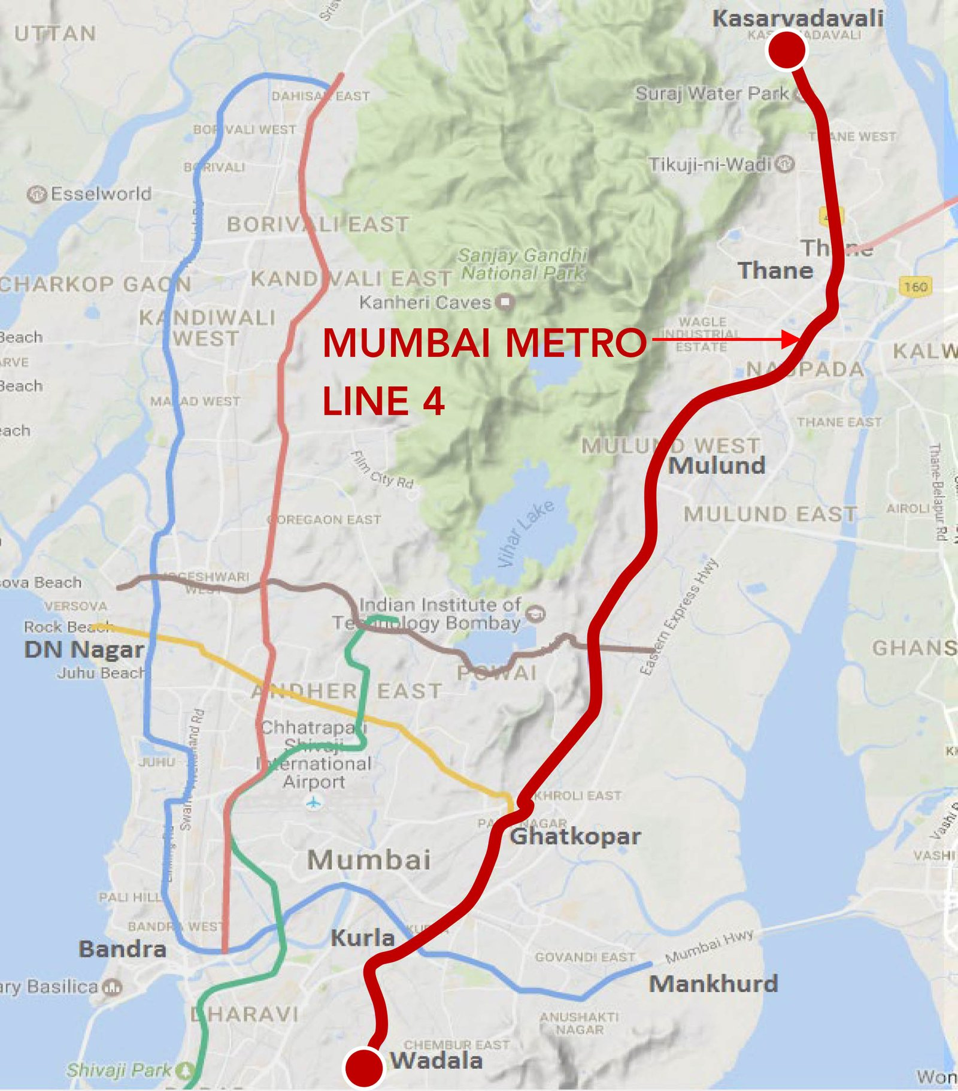
Background:-
Mumbai metro line 4 will serve as a medium off fast communication between Wadala and kasarvadavali
It integrates key roads like Eastern Express Highway, LBS Marg, and Ghodbunder Road, with interchanges to Metro Lines 2B, 5, 6, and 10, aiming to reduce travel time by up to 75%
Length :32.32 km with four major stations:
BHAKTI PARK METRO
CADBUARY
GAIMUKH
.

Slide 3
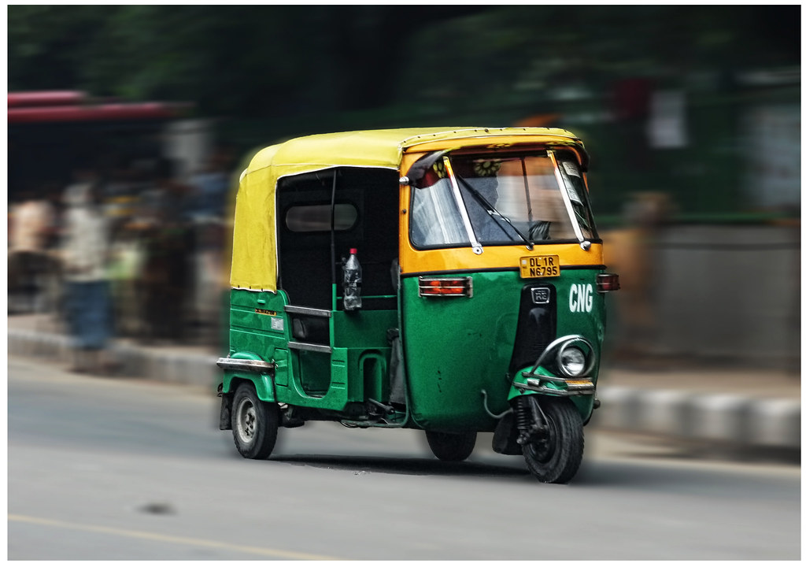
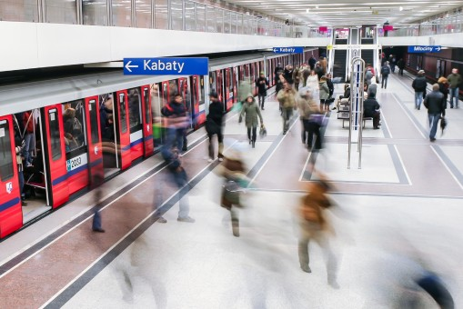
Missing your 08:30 morning metro
Wait metro is late by 3 minutes
Missing Ghatkopar Local by 2 minutes
But why ????
Ever wondered why are they late sometime ??
And this is what we are going to see.

Slide 4
Project Scope & Objective
To simulate realistic train movement, station halts, and safe train spacing for the Mumbai Metro Line 4 & 4A corridor, which is currently under construction
To design a headway-compliant movement model based on CBTC
(Communication-Based Train Control) principles.
To generate station-wise timetables, train speed profiles, and visual delay propagation analysis.

Slide 5
Expected outcomes
Dynamic Timetable: Arrival and departure at each station, including delay impact
Speed Profile Charts: Including zones where average speed was increased
Delay Heatmaps: Showing how delays affect later trains
Headway Monitoring: Alerts when spacing drops below 180 seconds

Slide 6
"In what ways does dwell time influence train movement and overall metro operations?"
Headway :Headway in metro systems refers to the time interval between two consecutive trains traveling in the same direction on the same track
Dwell time: Dwell time in metro systems refers to the amount of time a train spends at a station without moving. This period typically includes:
Passenger boarding and alighting
Door opening and closing
Any delays due to crowding or platform congestion

Slide 7

Dwell time
Headway
3 Min
Naval housing
Bhandup Metro
Shangrilla

Slide 8
Relationship Between Dwell Time and Headway in Metro Systems
Dwell time and headway are tightly interconnected in metro operations, and changes in one can significantly affect the other. Here's how they relate:
How Dwell Time Impacts Headway
Longer dwell times at stations mean trains spend more time stopped, which increases the minimum possible headway between trains.
Shorter dwell times allow trains to depart sooner, enabling tighter scheduling and higher service frequency.
Operational Consequences
If dwell time is inconsistent or unpredictable, it can cause train bunching, delays, and reduced throughput.
Optimizing dwell time is essential for maintaining regular headways, especially during peak hours.

Slide 9
Target
Just Being The Manager In This Relationship

Slide 10
Data collection and Assumptions
Station data from DPRs & planning maps.
Civil speed limits applied to each section (35–80 km/h).
OpenCV used on Ghatkopar Station visuals to estimate:
Passenger density
Dwell time patterns
Assumptions:
Dwell time: 30–60 sec
Headway: 180 sec
Terminal turnaround: 180 sec
Interchange buffer: 15–30 sec

Slide 11
Feature Engineering
Feature extraction task was performed in this duration with the help of Mrs Gabriel ion
Built structured dataset:
Station names
Inter-station distances
Speed limits
Dwell time estimates
Terminal behavior
Applied civil speed limits from the tender report

Slide 12
Simulation Engine Development
Developed in C++
Train modeled with:
Position, speed, dwell state, delay status
Implemented CBTC-style logic:
Safe headway checks
Real-time delay handling
Station-based halting rules
Delay ripple handled by occupancy blocking

Slide 13
Speed & Headway Control Logic
Average speed: ~35–40 km/h
Increased speed allowed if:
Long gaps ahead
Long block sections
Low platform congestion
Speed reduced when:
Ahead block is occupied
Approaching terminal/station
Headway limit close to violation

Slide 14
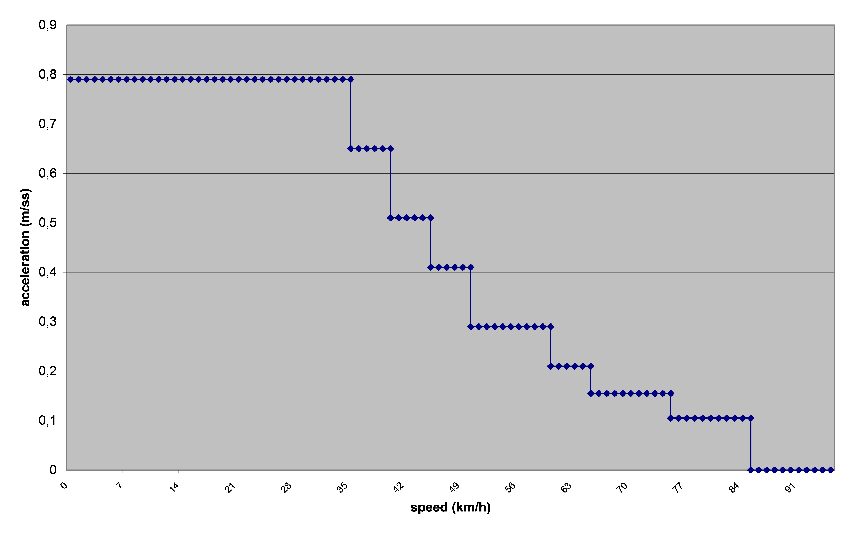
Results:

Slide 15
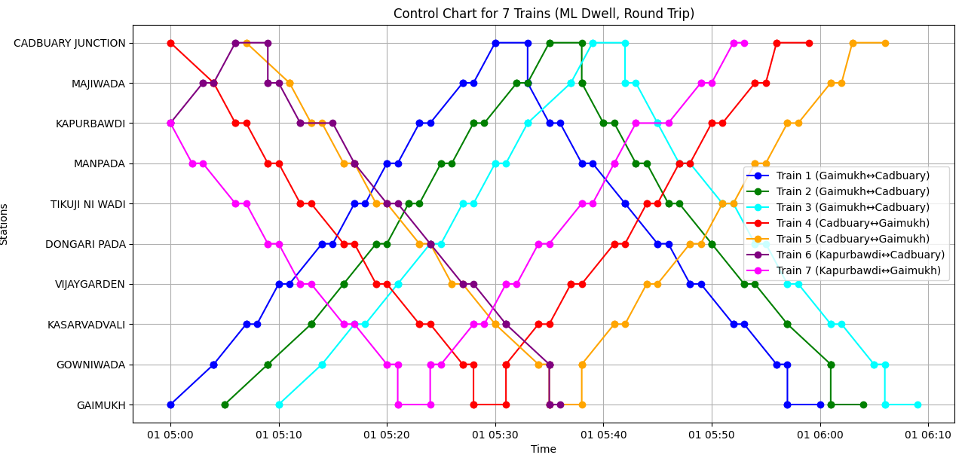

Slide 16
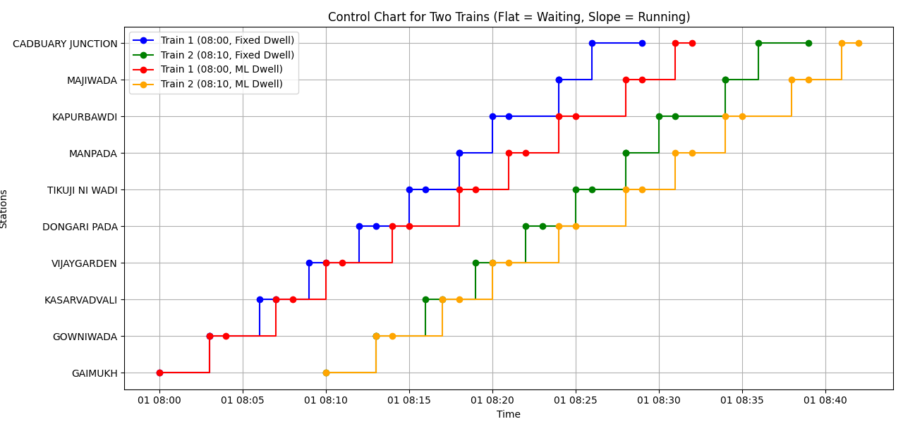

Slide 17
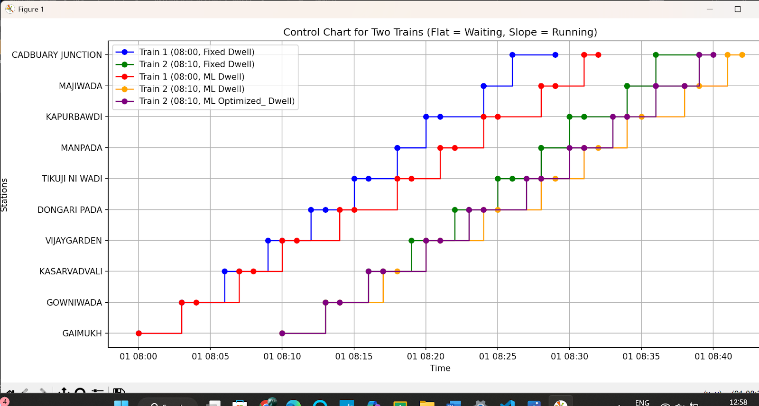

Slide 18
Thank You

